Slide 1

HUMAN EYE MOBILE TECHNOLOGY
(HEMT)
By
BHUVANESHWAR.V
IMAYAVARAMBAN.R
Rmk Engineering College

Slide 2
TECHNOLOGY INTRODUCTION
Human Computer Interaction(HCI):
HCI is the study of how people interact with the computers and to what extent computers are developed for successful interaction with human beings.
The aim of HCI is to reduce the effort users exert when accessing applications on limited form factor devices such as mobile phones.
Human Phone Interaction(HPI):
HPI extends the challenges not typically found in HCI research, more specially related to the phone and how we use it.

Slide 3
HPI CHALLENGES
It should not rely on any external devices other than the mobile phone itself.
It should be readily usable with minimum user dependency as possible.
It should be fast in the inference phase.
It should be lightweight in terms of computation.
It should preserve the phone user experience, e.g., it should not deplete the phone battery over normal operations.

Slide 4
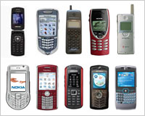
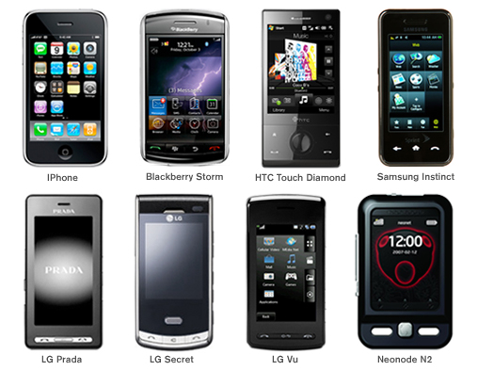
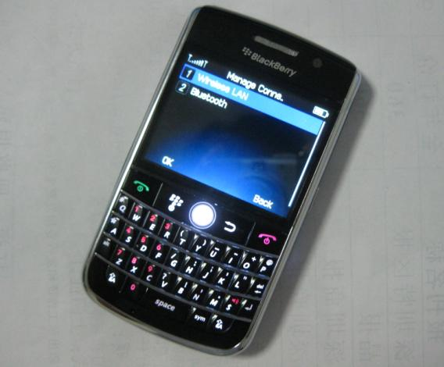
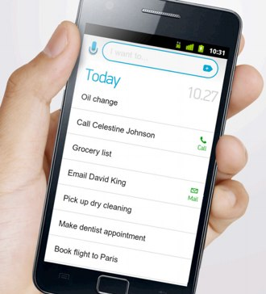
HPI EVOLUTIONS
1983 Keypad
1993 Touch Screen
2006 Trackball
2011 Voice Operated

Slide 5
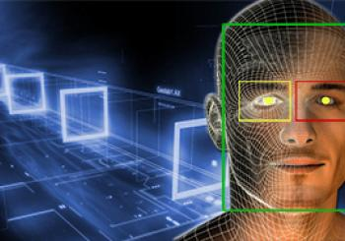
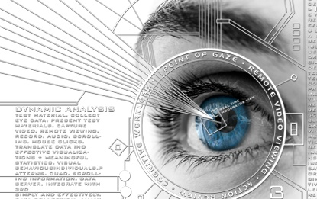
What’s Next……?????
Human Eye Mobile Technology
Hand free interfacing system
Works by user’s eye movement
Eye is tracked and the position is inferred
Tracking is done through the front camera

Slide 6
HEMT Design
The HEMT algorithmic design breaks down into the following pipeline phases:
1) An eye detection phase
2) An open eye template creation phase
3) An eye tracking phase
4) A blink detection phase
We develop eye tracking and blink detection mechanisms based on algorithms originally designed for desktop machines using USB cameras.

Slide 7
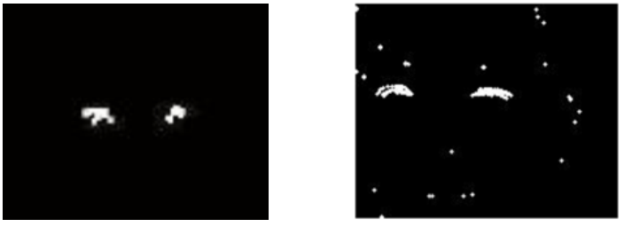
1.Eye Detection Phase
This phase consists on finding the contour of the eyes, by applying a motion analysis technique which operates on consecutive frames . The eye pair is identified by the left and right eye contours.
Results of original algorithm running on a desk-top with a USB camera
Results of Eye tracking running on a Nokia N810.

Slide 8
Based on the experimental observations and analysis, the original algorithm is modified as,
Reducing the image resolution, which reduces the eye detection error rate
Adding two more criteria to the original heuristics that filter out the false eye contours
width_{min} ≤ width ≤ width_{max}
height_{min} ≤ height ≤ height_{max}
width_{min,} width_{max,} height_{min}, height_{max} are thresholds, which identify the possible sizes for a true eye contour, are determined under various experimental conditions (e.g., bright, dark, moving, not moving) and with different people. This design approach boosts the eye tracking accuracy considerably

Slide 9
2.Open Eye Template Creation
HEMT creates a template of a user’s open eye once at the beginning when a person uses the system for the first time using the eye detection algorithm.
The template is saved in the persistent memory of the device and fetched when HEMT is invoked
Downside of this off-line template creation approach is that a template created in certain lighting conditions might not be perfectly suitable for other environments

Slide 10
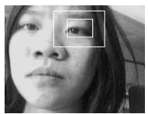
3.Eye Tracking Phase
The eye tracking algorithm is based on template matching. The template matching function calculates a correlation score between the open eye template, created the first time the application is used, and a search window.
Based on the previous analysis experiments for eye tracking, the following are inferred:
Outer box around the left eye encloses the region where the correlation score is calculated. If the normalized correlation coefficient equals 0.4 we conclude that there is an eye in the search window. This threshold has been verified accurate by means of multiple experiments under different conditions (e.g., bright, dark, moving, not moving)

Slide 11
Correlation:
Correlation is a measure of the degree to which two variables agree, not necessary in actual value but in general behavior.
The two variables are the corresponding pixel values in two images, template and source.
x is the template gray level image
x is the average grey level in the template image
y is the source image section
y is the average grey level in the source image
N is the number of pixels in the section image
(N= template image size = columns * rows
The value cor is between –1 and +1, with larger values representing a stronger relationship between the two images

Slide 12
4.Blink Detection
To detect blinks they apply a thresholding technique for the normalized correlation coefficient returned by the template matching function
Problems:
Quality of the mobile camera is not the same as a good USB camera, and the phone’s camera is generally closer to the person’s face than is the case of using a desktop and USB camera. Because of this latter situation the camera can pick up iris movements, i.e., the interior of the eye, due to eyeball rotation.
In particular, when the iris is turned towards the corner of the eye, upwards or downwards, a blink is inferred even if the eye remains open. This occurs because in this case the majority of the eye ball surface turns white which is confused with the color of the skin
Solution:
Improve the quality of the camera so as to obtain clear contours and to avoid detection of iris movements.

Slide 13
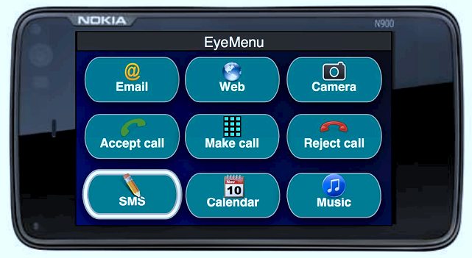
APPLICATIONS
1.Eye Menu:
An example of an HEMT application is Eye Menu. Eye Menu is a way to shortcut the access to some of the phone’s functions. The set of applications in the menu can be customized by the user. The idea is the following: the position of a person’s eye is mapped to one of the nine buttons. A button is highlighted when HEMT detects the eye in the position mapped to the button. If a user blinks their eye, the application associated with the button is lunched. Driving the mobile phone user interface with the eyes can be used as a way to facilitate the interaction with mobile phones or in support of people with disabilities.

Slide 14
2.Car Driver Safety
HEMT could also be used to detect drivers drowsiness and distraction in cars. While car manufactures are developing technology to improve drivers safety by detecting drowsiness and distraction using dedicated sensors and cameras, HEMT could be readily usable for the same purpose even on low-end cars by just clipping the phone on the car dashboard.
Among the above technologies used GPS is widely used. The other technologies are still in the developmental stage and they have not yet found their foot on the global market.
Also the statistics about the accidents that has taken place in the past four years should be taken into consideration

Slide 15
CONCLUSION
This paper describes work on designing and developing the hand free interfacing system between human eye and mobile device. The work is yet in progress for creation of various phases. HEMT technology will be a promising approach to drive mobile application as hand free manner.

